Slide 1
Istanbul Shopping Malls Data Analysis
Data Analysis Project(2021-2023)
Presented by: EdigaJayanthi.

Slide 2
Introduction & Project Overview
Objective: Analyzing retail data of 10 shopping malls in Istanbul to improve business performance.
Dataset Attributes: Invoice No, Gender, Age, Category, Quantity, Price, Payment Method, Shopping Mall.
Key KPI Created: Revenue = Quantity × Price.

Slide 3
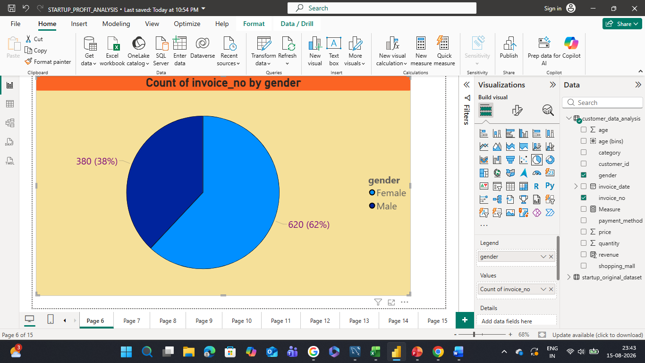
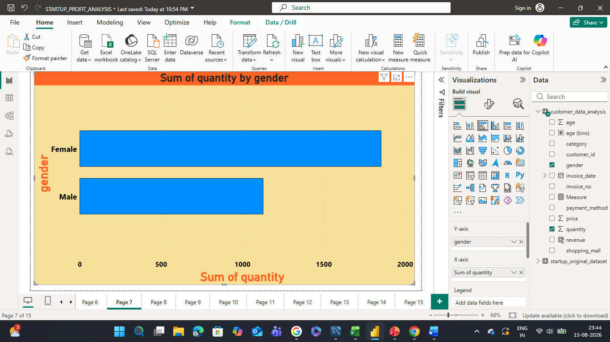
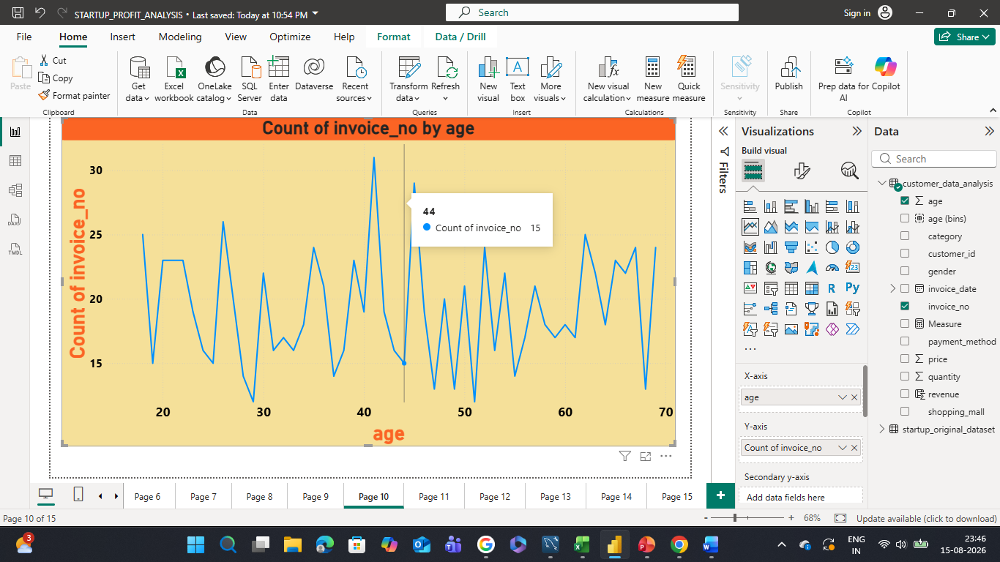
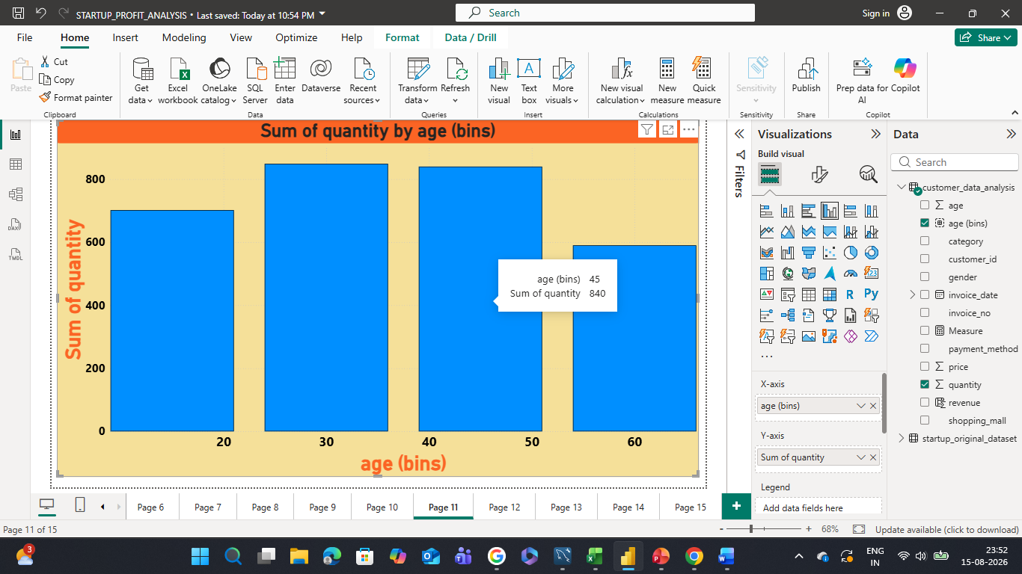
Customer Profiles(Gender & Age Analysis)
Key Point 1: Females contribute to the highest number of transactions and revenue.
Key Point 2: The working-class segment (30-50 age group) spends the most money.

Slide 4
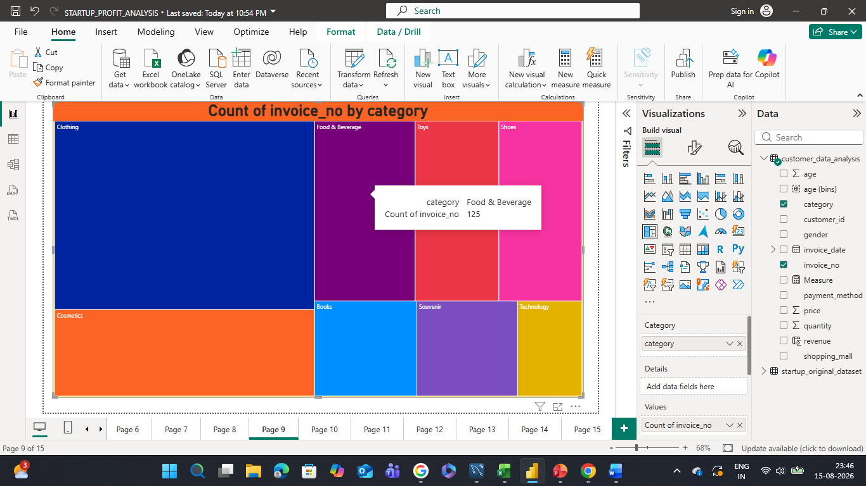
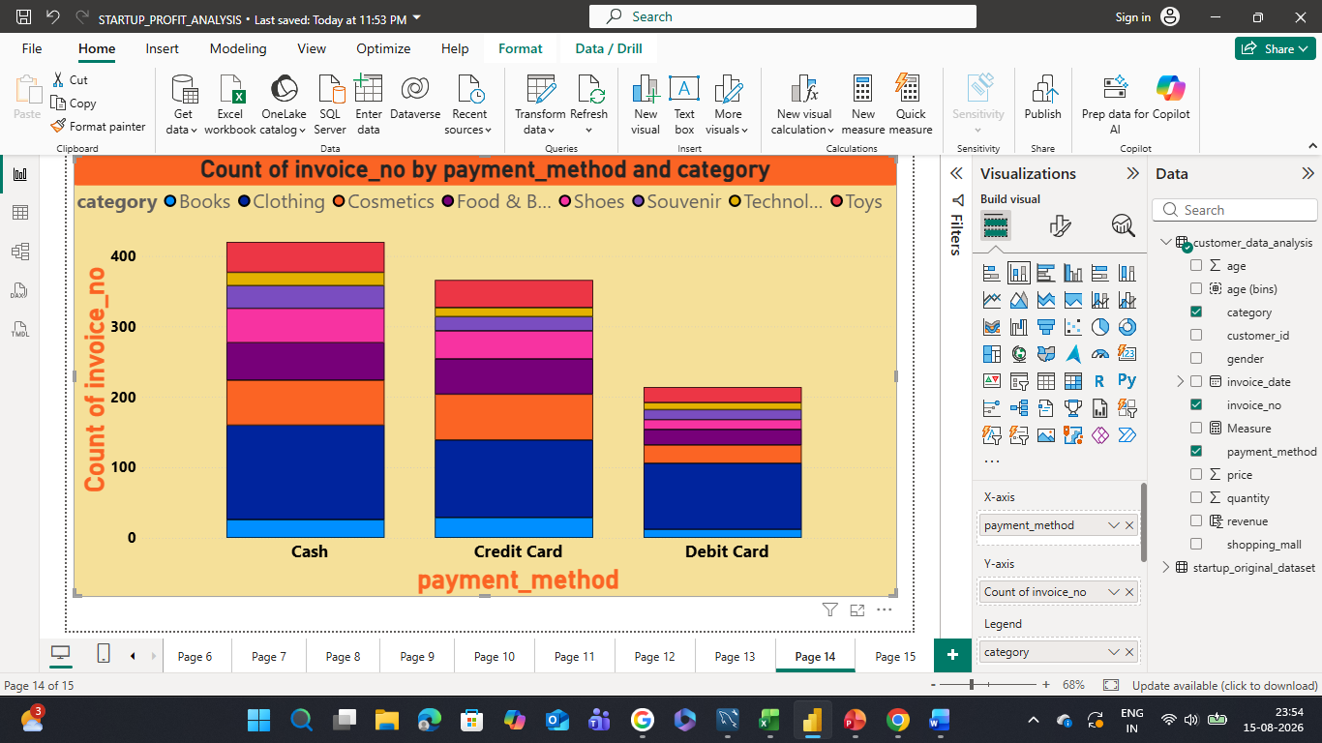
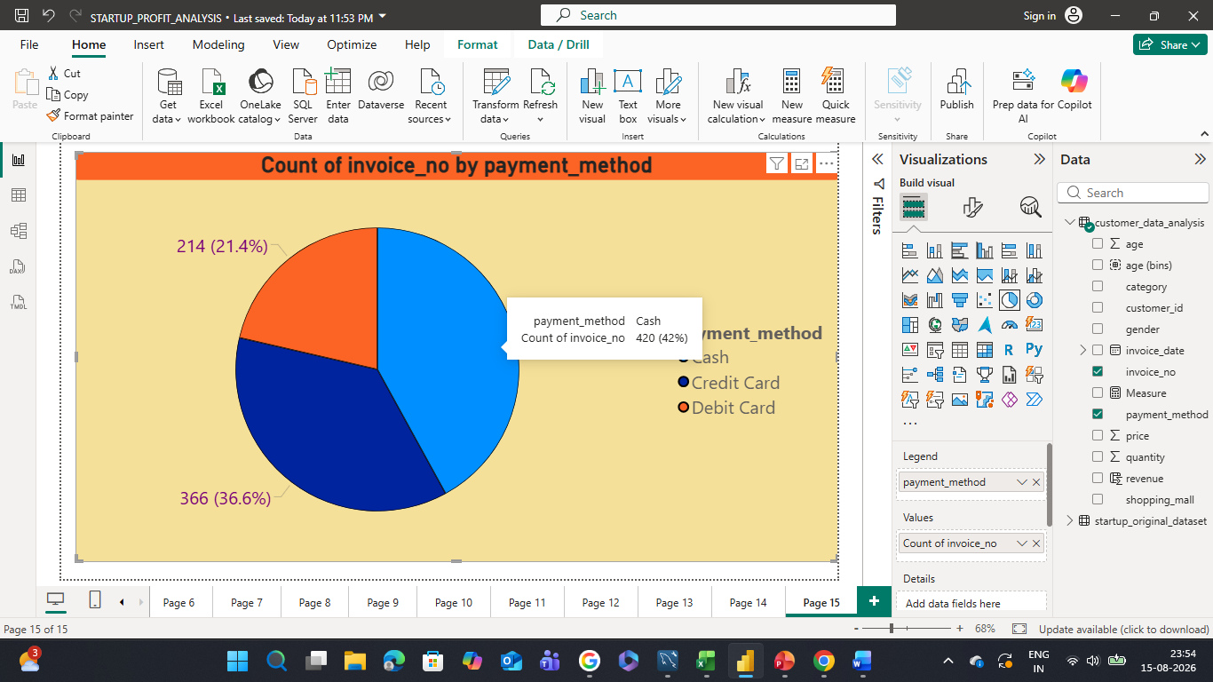
Product & Payment Performance
Key Point 1: Clothing and Shoes are the top-performing categories by sales.
Key Point 2: Credit Cards are highly preferred for expensive items like Electronics.

Slide 5
Business Recommendations
* Targeted Marketing: Launch weekend discounts on Clothing and Cosmetics for female shoppers.
* Family Offers: Introduce family-centric rewards to target the high-spending 30-50 age category.
* Bank Tie-ups: Partner with banks for Credit Card cashbacks and EMI options on expensive Electronics.
* Stock Clearing: Bundle slow items like Books with Clothing as "Buy 1 Get 1" offers.

Slide 6
Conclusion
Thank You!
Questions & Answers

